Slide 1
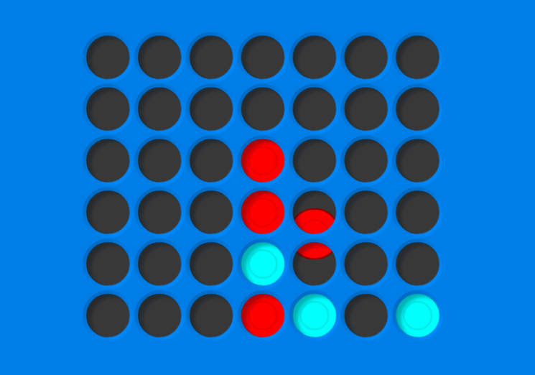
Connect 4 AI
Group 7 – 方治欣 曹松晖 任怡静

Slide 2
Video Showcase
Speed Comparison: Minimax < A-B Pruning < Pruning + Cache
A-B pruning provides a massive boost, cache provide a noticeable small boost.
Versus Testing: Minimax wins Random consistently (If the heuristic is good); Higher search depth (3+) wins Greedy(search depth = 1)

Slide 3
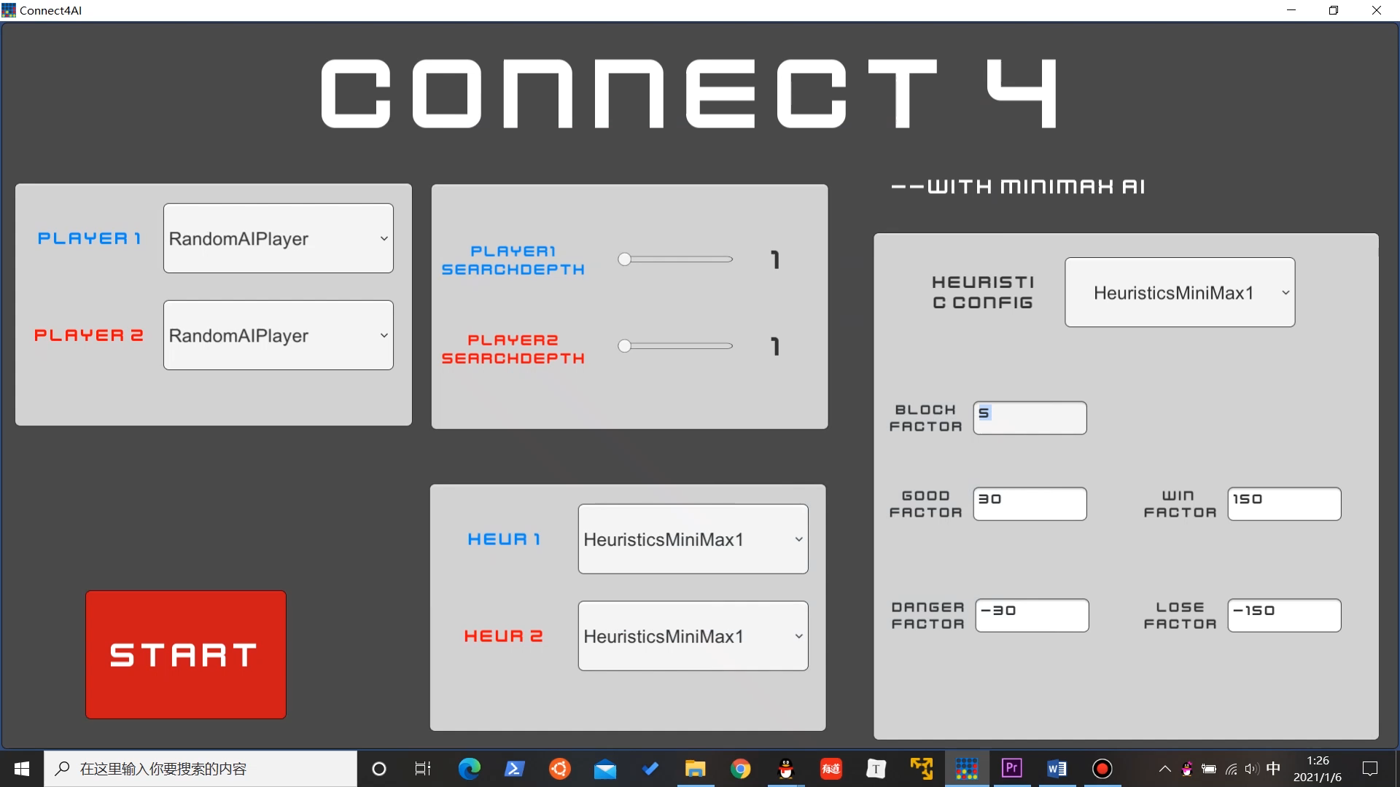

Slide 4

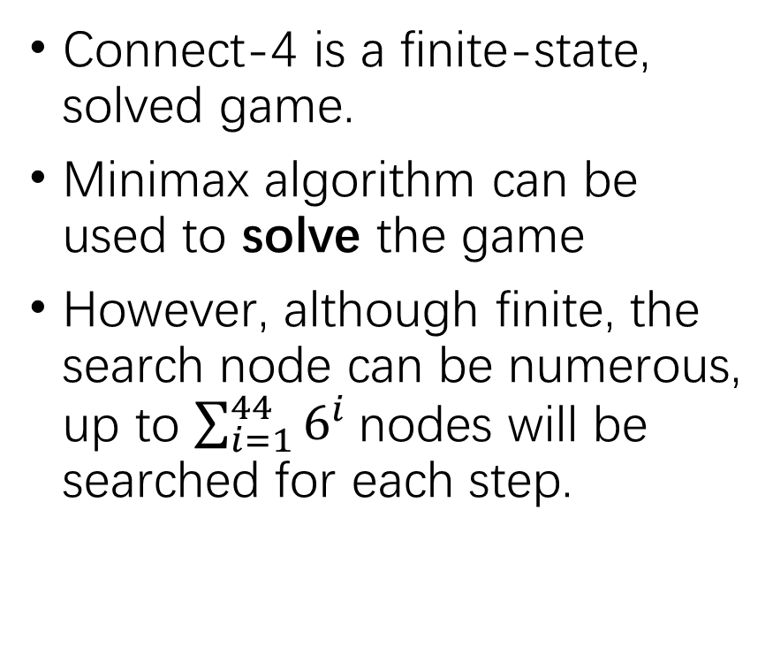
Algorithm
Connect-4 is a finite-state, solved game.
Minimax algorithm can be used to solve the game
However, although finite, the search node can be numerous, up to ${\sum_{i=1}^{44}{6^{i}}}^{ }$nodes will be searched for each step.

Slide 5
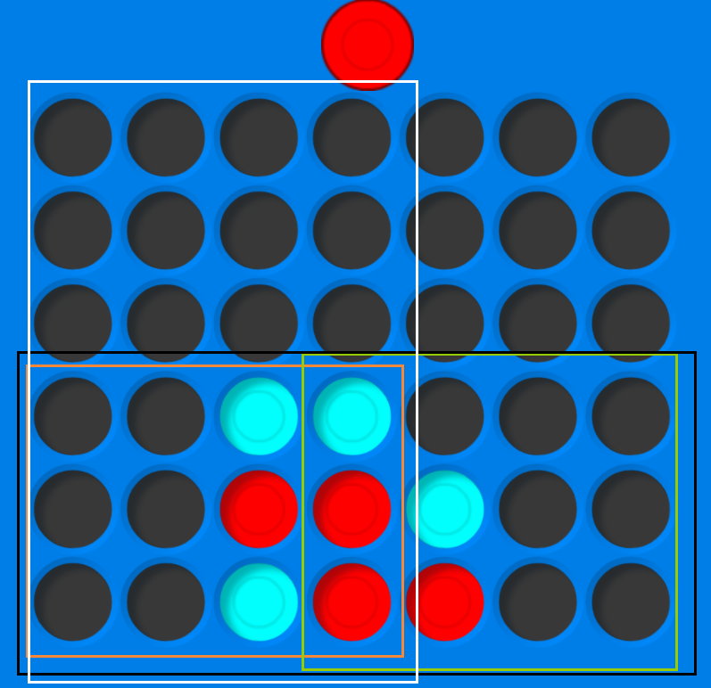
Algorithm
Minimax: Alpha-Beta Pruning + Caching
Limit search tree depth, use Heuristic as estimated utility

Slide 6
Implementation: Heuristic
Statistic Approach: A state’s utility is decided by all the 4-lines in that state. (a 4-line means consecutive 4 slots)
6 types: Block, Good, Win, Danger, Lose, Empty
5 Parameters to decide the value of those 4-lines
To cover all the 4-lines in a state, divide the field as this:

Slide 7
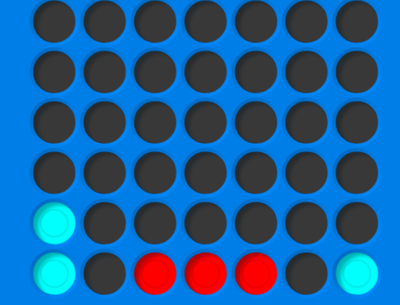
Implementation: Heuristic
A block line is a 4-line where there’re both color present.
A good/danger line is a 4-line where there’re only one color present. The more pieces filled, the better/more dangerous.
A win/lose line is a 4-line filled with a single color.
Good for blue
Good for red

Slide 8
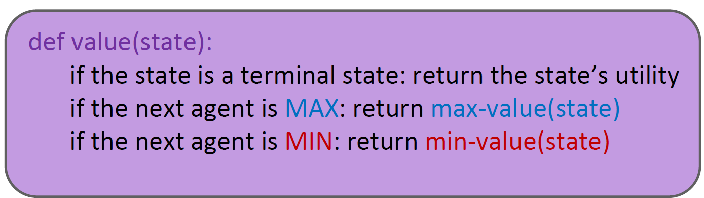
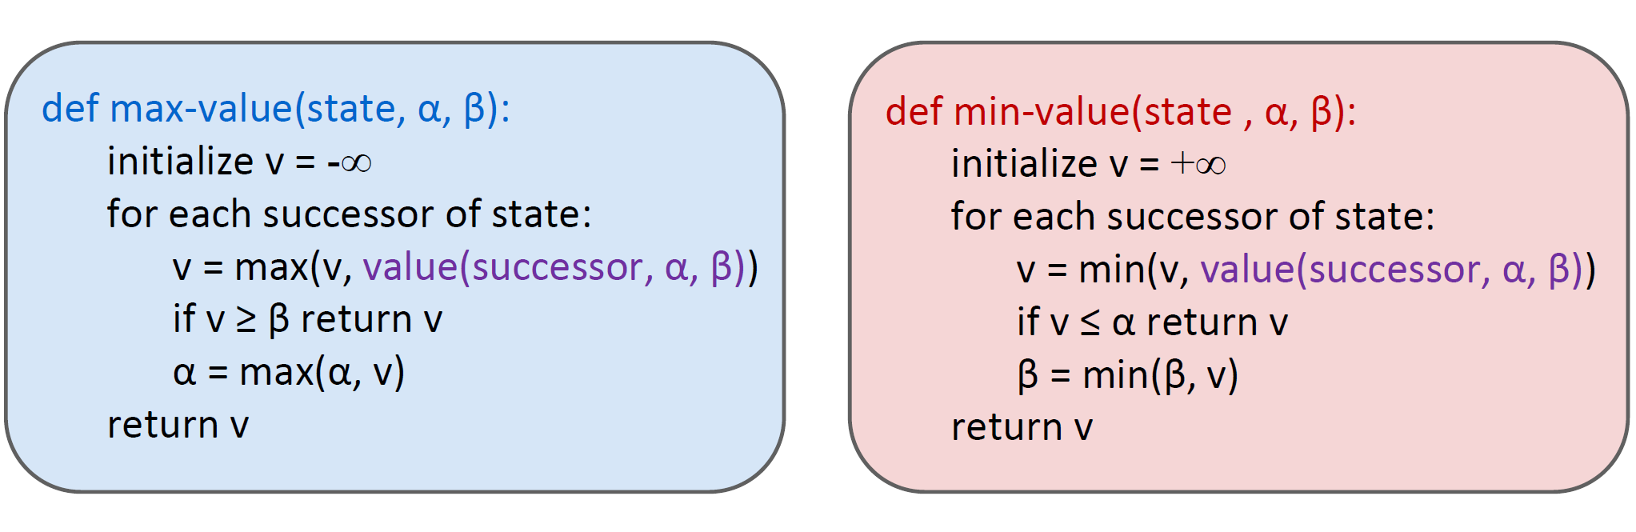
Implementation: Minimax+Pruning
Minimax is mostly the same as lectured.
Utility is generated by heuristic,
i.e. performance is dependent on heuristic parameter design

Slide 9
Implementation: Heuristic Design
General principle that you should follow:
Positive Good & Win factor, Win factor >> 4*Good factor
Negative Danger & Lose factor, Lose factor << 4*Danger factor
Make block factor positive for a more defensive behavior
Good for blue
Good for red

Slide 10
Implementation: Caching
The order of actions does not matter for the state’s evaluation.
In a single search, multiple repeated state can appear in the search tree
Cache the value when a state is evaluated.
Before checking the successor, check the cache. If we have a value, directly use it, ignore all of its children(because they will be the same as the cached one)
2
1
2
3
1
3
=
3
1
3
2
1
2

Slide 11
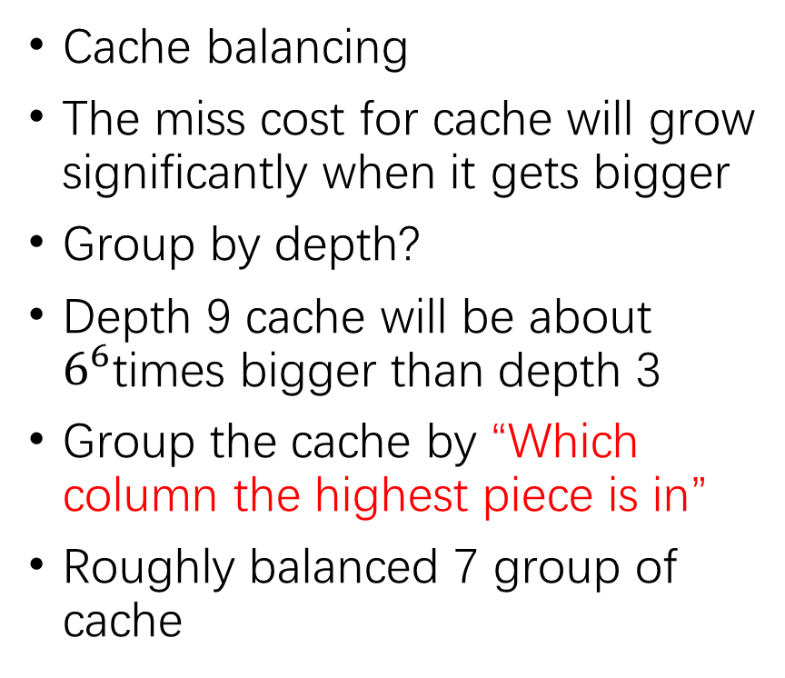
Implementation: Caching
Cache balancing
The miss cost for cache will grow significantly when it gets bigger
Group by depth?
Depth 9 cache will be about $6^{6}$times bigger than depth 3
Group the cache by “Which column the highest piece is in”
Roughly balanced 7 group of cache
2
1
2
3
1
3
=
3
1
3
2
1
2

Slide 12
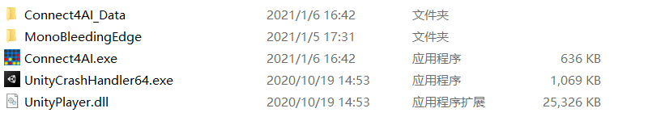
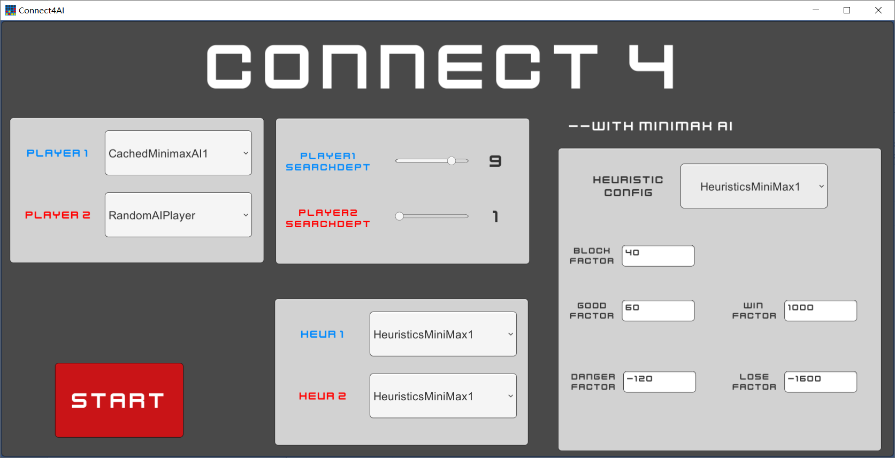
Result
As the video has shown, we get everything ready.
A full build will be uploaded, in which you can play with the AI yourself, or watch them play.
We got two heuristic in it, a good one and a not that good one. You can tweak them for fun.
Suggested search depth: 5 for minimax, 7 for pruning, 9 for cached minimax.

Slide 13
THANK YOU FOR WATCHING

